Slide 1
Unit 1: For Live Session
DS6306
Garrity

Slide 2
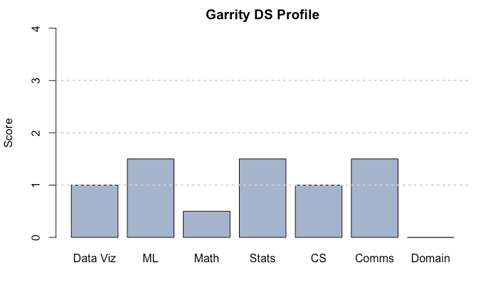
Problem 1. Data Science Profile

Slide 3
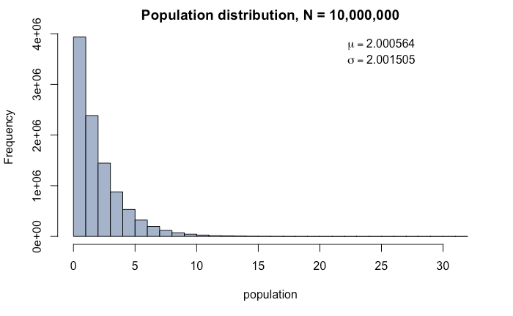
Problem 2. Chi-square distribution sampling

Slide 4
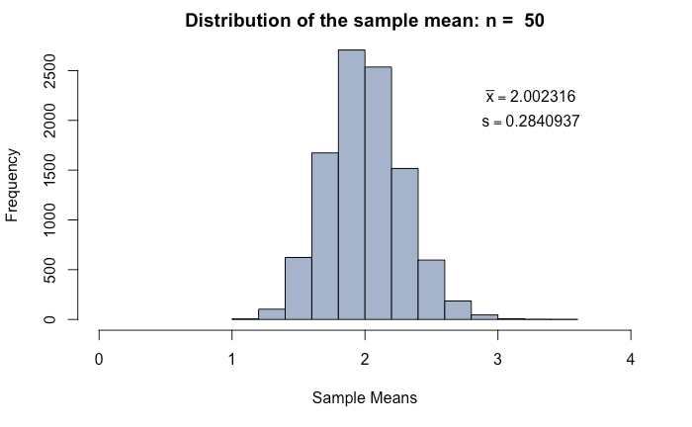
Problem 2. Chi-square distribution sampling, continued...
According to the CLT, we expect the sampling distribution to be normally distributed with:
xbar = 𝜇 = 2
s = 𝜎/√n = 0.283

Slide 5
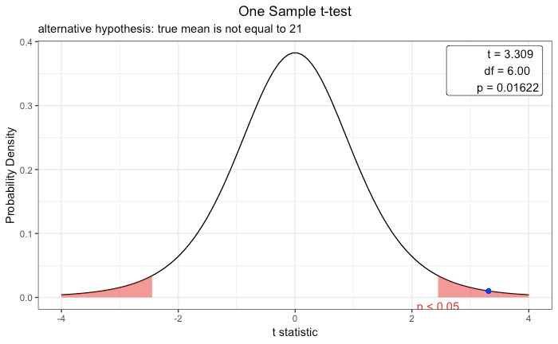
Problem 3. Beachcomber patron age
Step 1. H₀: 𝜇 = 21, H_{a}: 𝜇 ≠ 21
Step 2. Draw and shade. Critical t-value = 2.447
Step 3. t-statistic = 3.309
Step 4. p-value = 0.01622
Step 5. Reject H₀
Step 6. There is evidence to suggest that the true mean age of Beachcomber patrons is not equal to 21 (p<0.05).
*thank you, Malcom Carlson

Slide 6
Takeaways and Questions
GitHub is awesome and the RStudio integration is very handy. I’ve been using Python Jupyter notebooks and am pleasantly surprised to see that RMarkdown provides a very similar IDE. These tools are great for collaboration, documentation, and reproducibility.
The divide between data science and statistics appears to be somewhat artificial and maybe a touch political.
I’m familiar with towarddatascience.com. Are there any other websites, blogs, or journals that you recommend we read?

